Slide 1
Lecture 7. Unified Development Process, and
Unified Modeling Language
Object Oriented Modeling Technology
面向对象建模技术
Professor: Yushan Sun
Spring Term 2019

Slide 2
内容提要：
1. Review of Earlier Software Development Models
早期软件开发模型回顾 (Priestley 3.1-3.2)
2. The Unified Process
统一过程模型 (Priestley 3.3)
3. The Unified Modeling Language
Language (Priestley 1.3)
4. The Use of UML in the Unified Process
(Priestley 3.5)

Slide 3
Review of Earlier Software
Development Models

Slide 4
1. Review of Earlier Software Development
Models 早期软件开发模型回顾
This section will have a review of the
following Models:
The Waterfall Model （瀑布模型）
Evolutionary model （进化模型）
Spiral model (螺旋模型)
An Iterative and Incremental Process Model （迭代-渐增过程模型）

Slide 5
THE WATERFALL MODEL
Requirements
文档
瀑布模型
Analysis
文档
Design
文档
Coding
文档
项目开发进程从一个阶段
“流动”到下一个阶段，这
也是瀑布模型名称的由来。
Testing
文档
Maintenance
The waterfall model (Royce 1970)

Slide 6
About waterfall model:
  The different stages are to be carried out consecutively (连贯的开发阶段）
  At each stage, the work done will be documented, which will form the basis for the work that is done at the next stage （每个阶段都有文档，上一个阶段的文档是下一个阶段文档工作的基础）
  After deployment, the system will be maintained as long as it remains in service （系统部署后，进入维护阶段）

Slide 7
瀑布模型的贡献：
直观性、通用性：It is an intuitive, sensible and general-purpose engineering approach to software engineering.
计划性：It emphasizes planning for an activity before carrying it out, better than just start coding without considering overall architecture of the program.
自顶向下性: It recommends a top-down approach, from high level of abstraction to more details
软件开发的可管理性。It provides a strong management tool for controlling software projects

Slide 8
问题：使用瀑布模型进行开发的时候，某阶段发生错误的时候，只能后退一步进行修改。
If errors are found when working on one stage, it is reasonable to correct the problems before proceeding.
However, Some earlier versions of the waterfall model restricted feedback to the previous stage in the process only.

Slide 9
Evolutionary model 进化模型
Evolutionary model suggests that
  software should be developed in a more ‘evolutionary’ manner. 软件开发应该遵循进化方式

Slide 10
Prototype
系统原型
Specification
Initial
Version
Intermediate Version1
Outline
Description
Development
Intermediate Version2
Intermediate Version3
系统粗略描述
Intermediate Version4
Intermediate Version5
Final
Version
Validation
最终版本

Slide 11
How evolutionary model works?
使用原型。Development starts with the production of a prototype system implementing only the core functionality of the complete system.
征求用户意见。The prototype will be used to discuss with the users
改进。Feedback from the users would then guide subsequent development, …
原型进化。The prototype would evolve into a more complete system, with small increments of functionality being added at any given stage and repeated consultations with the users taking place.

Slide 12
进化模型的优点:
及早发现并修正错误.
By involving users in the development process, the problem of discovering errors late has been overcome.
2. 及时测试.
A series of working prototypes mean that the evolving system was being tested from an early stage in a project

Slide 13
进化模型的缺点
计划困难.
It is very difficult to see how project managers could sensibly plan a project.
b) 不能保证最后能得到一个稳定的系统.
The model gives no guarantee that the evolutionary process will in fact ever converge on a stable system.

Slide 14
Spiral model
The spiral model (Boehm 1988) was developed in an attempt to
  develop an explicit software process that addressed the weakness of the waterfall model （克服瀑布模型的缺点）
  reserve more of its traditional management oriented advantages than the evolutionary model （保持瀑布模型的优点）

Slide 15
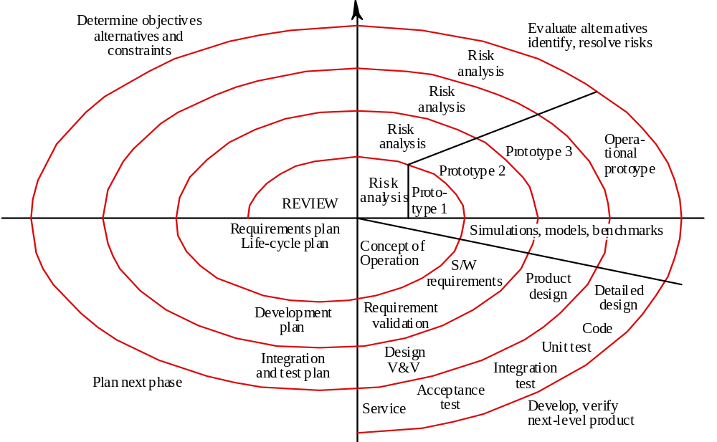
Q2
评价所选择的方法
确认风险
解决风险
确立：
目标
可选择的方法
限制
Q1
Q4
计划下一
个阶段
Q3
开发、验证并且确定下一个阶段（迭代）产品
The spiral model (after Boehm 1988)

Slide 16
Q1: Objective setting(目标的确立)。
  Specific objectives for that phase of the project are defined (定义明确的目标).
  Constrains on the process and product are identified and （确认限制）
  a detail management plan is drawn up (制定详细管理计划).
  Project risks are identified（确定项目风险）.
  Alternative strategies, depending on these risks, may be planned （计划替代策略）.

Slide 17
Q2: Risk assessment and reduction（风险评估、减少风险）。
For each of the identified project risks, a detailed analysis is carried out(详细分析)
Steps are taken to reduce the risk （风险减少）.
  For example, if there is a risk that the requirements are inappropriate, a prototype system may be developed（开发原型的必要）.

Slide 18
Q3: Development and validation (开发与验证)。
After risk evaluation, a development model for the system is then chosen. For example,
  if user interface risks are dominant, an appropriate development model might be evolutionary prototyping（用户图形界面风险，开发模型：采用进化原型模型）.
  The waterfall model may be the most appropriate development model if the main identified risk is the sub-system integration（子系统整合风险：采用瀑布模型）.

Slide 19
Q4: planning （计划）。
The project is reviewed and a decision made whether to continue with a further loop of the spiral （决定是否进入下一个循环）.
If it is decided to continue, plans are drawn up for the next phase of the project（如果是要进行新的循环，则需要制定下一个阶段的计划）.

Slide 20
螺旋模型的特点: 迭代
Each complete rotation represents a single iteration of the project, but
Different iterations will involve different activities and will not all take the same elapsed time （不同的迭代有不同的开发活动，并且所耗费的时间也不同）.
The four quadrants represent the four main activities that the model proposes should be undertaken in each iteration.

Slide 21
主要特点 (Main characteristics):
  It is a hybrid model that supports process iteration (支持过程迭代)
  The process is represented as a spiral, each loop in the spiral representing a process phase (每个螺旋代表一个过程阶段)
  Four sectors per loop (每次循环都有4个区)
  1) objective setting,
  2) risk assessment and reduction,
  3) development and validation,
  4) planning

Slide 22
迭代渐增开发
Iterative and incremental development
渐增式的开发 (例如: evolutionary model):
Software development should take place incrementally:
  首先开发核心功能，直到得到一个工作系统. develop core functionality first, to the level of getting a working system, and then
  然后再逐渐添加其余功能. add the remaining functionality incrementally, in a series of increments

Slide 23
迭代式开发 (例如: spiral model):
将软件项目管理成一系列的迭代. Software projects be managed as a series of iterations;
而不是一次使用瀑布模型就可以完成的. Not just as a single pass through the various activities identified in the waterfall model
问题：是否可以将以上两者结合？

Slide 24
An Iterative and Incremental Process
将迭代式与渐增式结合
R
R
R
D
D
D
C
C
C
I
I
I
T
T
T
此模型与Spiral Model 不同: 在Spiral Model 中每次迭代的内容是不一样的
Time
Release 1
Release 2
Release N
Back

Slide 25
Unified Software Development Process
统一软件开发过程

Slide 26
2. THE UNIFIED PROCESS 统一过程-
Priestley 3.3
The Unified Process attempts to reconcile these two forces
  iterative (迭代) and
  incremental (渐增)
with the overall model of the development process (see Figure 3.3).

Slide 27
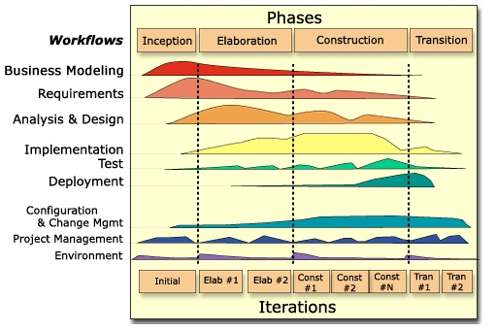
Time
Activities
an overview of the unified process

Slide 28
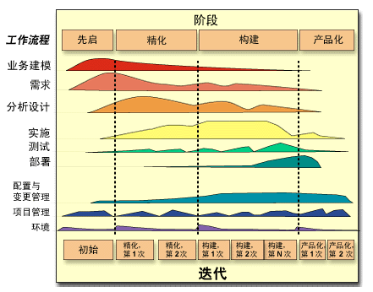
RUP 二维过程结构
沿时间轴的组织结构
Time
沿内容轴的组织结构
Activities

Slide 29
确定生命周
期的目标
RUP的生命开发周期

Slide 30
确定生命周
期的架构
RUP的生命开发周期

Slide 31
获得可初步
运行的能力
RUP的生命开发周期

Slide 32
产品的
发布

Slide 33
先启阶段: 业务建模，需求，项目管理，风险评估. The inception phase is primarily concerned with project planning and risk evaluation.
精化阶段: 定义系统的整体架构. The elaboration phase is concerned with defining the overall architecture of the system.
构建阶段: 最后，软件可被发布，进行beta测试。 In the construction phase, the system is built(代码), ending with a release that can be delivered to the customers for beta testing.
产品化阶段: beta测试后，得到完整的系统的发布The transition phase covers the period of beta testing and terminates with the release of the completed system.

Slide 34
统一过程的特点
每项活动都可以在任何一次迭代发生，但是重心随着开发过程的进行，每次迭代的重心都不同
Each activity can occur in any iteration, but
the balance of activities in an iteration will change as the project progresses from inception to completion.

Slide 35
统一开发过程随着迭代次数的增加重心的转移情况。
…
迭代1
迭代2
迭代N
需求
需求
需求
分析/设计
分析/设计
分析/设计
实现
实现
实现
测试
测试
测试
部署
部署
部署

Slide 36
每个阶段都有里程碑: 项目开发的时间节点，每个阶段应该实现的目标
Each phase terminates with a milestone to capture the points within the project lifecycle

Slide 37
Major Milestones: Business Decision Points
Customer
Acceptance
or End of Life
Architecture
Base Lined
Product Sufficiently Mature for Customers
Scope and Business Case Agreement
Inception
Elaboration
Construction
Transition
time
Lifecycle
Objective
Milestone
2016-05-01
Lifecycle
Architecture
Milestone
2017-05-01
Initial Operational
Capability
Milestone
2017-12-30
Product
Release
2018-05-30
2015-09-01
Notes:
The phases of RUP were chosen such that phase boundaries correspond to significant decision points in the life of a project. For example, at the end of Inception, enough work has been done to capture the problem to be solved, and a vision of the system has been developed. An initial set of risks has also been identified and evaluated. Based on this information, a decision is made whether to fund the project. Similar decision points correspond to the end of Elaboration, Construction, and Transition.
Milestones help you to assess the progress of a project at key points. Management can use these to establish clear criteria from which to decide the course of a project. They provide opportunities to change course. However, unlike the waterfall approach, phases contain iterations which yield executable results.
Phases represent the management perspective of the project, the “35,000 foot level.” The details are left to the engineering perspective, which is at the iteration level.
The names of the milestones are identical to the ones proposed by Barry Boehm in the article “Anchoring the Software Process,” IEEE Software, July 1996, pp. 73-82.

Slide 38
每个阶段都有几次迭代，每次迭代都是一次迷你瀑布模型。
  Each phase can contain a number of iterations;
  Each iteration will typically be structured as a mini-waterfall process.

Slide 39
需求
分析/设计
实现
测试
部署
环境
配置与
改变管理
统一过程中的一次迭代
项目管理

Slide 40
产品在每次迭代都增加新内容与改善。
An iteration should result in an incremental improvement to the product being constructed.
迭代 1
迭代 2
迭代 3
迭代 4
迭代 5
迭代 6

Slide 41
统一过程的定制与剪裁
The Unified Process is not simply a process, but rather an extensible framework which should be customized for specific organizations or projects.
Resource
Time
先启
阶段
精化阶段
构建阶段
产品化
阶段
Back

Slide 42
THE UNIFIED MODELING LANGUAGE
统一建模语言

Slide 43
3. The Unified Modeling Language-Priestley 1.3
统一建模语言的来历？
In 1994, the Rational Software Corporation began the creation of a unified modeling language.
They integrated
  the Booch Method (Grady Booch),
  the Object Modeling Technique (OMT) (James Rumbaugh), and
  OO Software Engineering (OOSE), (Ivar Jacobsen)
with elements of other methods and published this new notation under the name UML.

Slide 44

5.1 the unified modeling language
A well-defined and expressive notation is important to the process of software development.
使用标准记号的好处
好处1：清楚地描述设计，为了交流
First, a standard notation can be used to describe a scenario or formulate an architecture and then communicate those decisions to others.
零 一 二 三 四 五 六 七 八 九 十
零 壹 贰 叁 肆 伍 陆 柒 捌 玖 拾
0 1 2 3 4 5 6 7 8 9 10

Slide 45

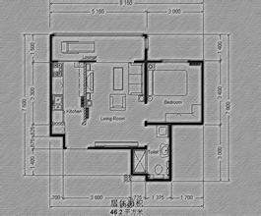
好处2: 为了解放大脑，关注解决更高级的问题
Second, by relieving the brain of all unnecessary work, a good notation sets it free to concentrate on more advanced problems.

Slide 46
5.1 the unified modeling language
A Brief Historical Perspective
统一建模语言是主要的建模语言；用于分析、明确说明、设计软件系统
The Unified Modeling Language (UML) is the primary modeling language used to
  analyze,
  specify, and
  design
software systems.

Slide 47
UML版本
In the mid-1990s, Rational Software Corporation published the 1st version of the UML.
In 1997, the UML was adopted as a standard (在1997年UML成为标准)
UML 2.0 is the version discussed in this text.
最新版本：UML2.5 (2015年6月发布)

Slide 48
UML试图在5个方面刻画一个软件
Views（视图）
UML is informed by a vision of the structure of software systems known as the 4+1 view model.
  a system's structure is described in five views,
  the use case view, has a special role to play in integrating the contents of the other four views.

Slide 49
可以在五个方面刻画一个软件
设计视图
用例视图
实现视图
Design
View
Use Case
View
Implementation
View
Process
View
Deployment
View
进程视图
部署视图
Fig 1.3 the 4+1 view model

Slide 50
每个视图反映了系统被观察的方面
Among the five views shown in Fig 1.3, each corresponds to a particular perspective from which a system can be examined.
不同的视图强调系统的不同方面，不同的利益相关者关心不同的视图。
Different views highlight different aspects of the system that are of interest to particular groups of stakeholders.

Slide 51
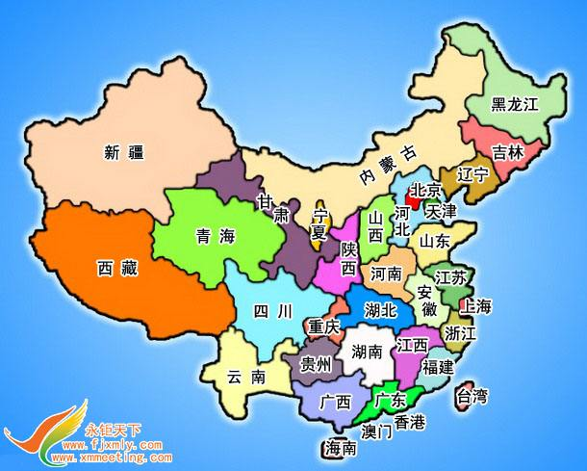
行政官员关心《中国行政区图》

Slide 52
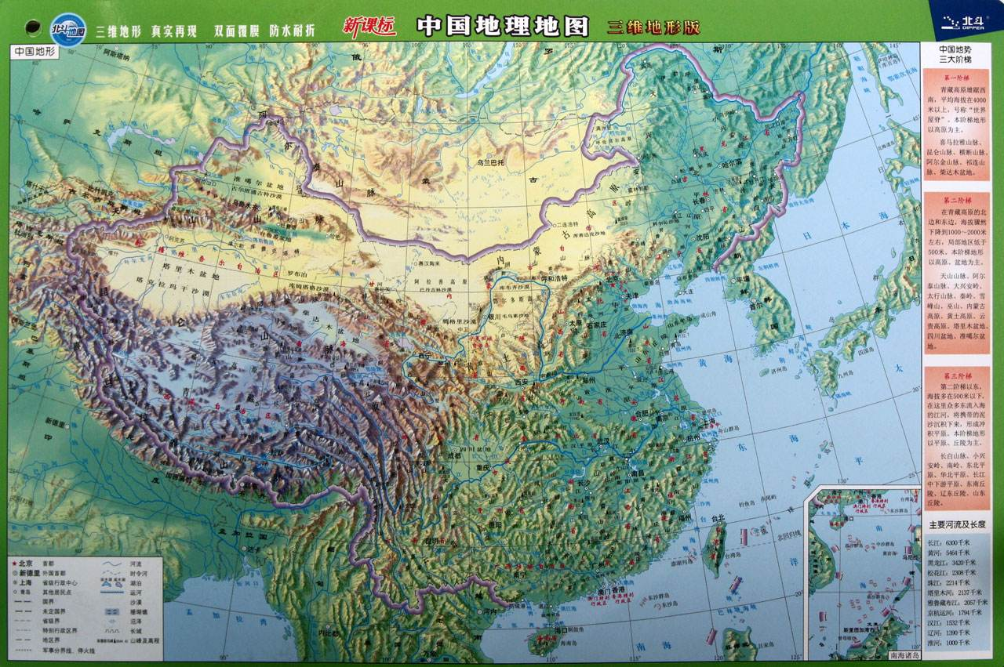
地理学家-驴友关心《中国地理地图》

Slide 53
Use Case View的意义：定义了系统的外部行为
The use case view defines the system's external behavior and is of interest to
  end users,
  analysts and
  testers.
用例图定义了系统需求，因此限制了其它的视图
This view defines the requirements of the system, and constrains all the other views,
  which describe certain aspects of the system's design or construction.
用例图可以被用来表达Use Case View
Use use-case diagram to express use case view

Slide 54

例子：ATM取款的用例
DrawCash
Customer
用例描述：用户和系统的交互
User inserts card
System reads card
System prompts user to enter password
User enters password
System displays a menu, which shows: withdraw, deposit, transfer
User selects “withdraw”
User enters amount
User takes cash from machine
User chooses “return card”
Card returned and system terminates
A use-case diagram

Slide 55
Design View的意义：
描述支持用例视图所述功能的逻辑结构。
The design view describes the logical structures that support the functional requirements in the use case view, including:
    definitions of program components, e.g., classes (定义程序构件，例如类)
    specifications of the data they hold (组件包含的数据类型)
    behavior (描述行为)
    Interactions (类与类之间的交互关系)
注：Design view: 对于程序员至关重要

Slide 56
Payroll
employee: Employee
Employee
+getValidTransaction()
+getMaster()
+calculateEmployeePay()
+calculteGrossPay()
+calculateTaxableBenefits()
+calculateTaxes()
+calculateNetPay()
+generateAccountingEntries()
+producePayCheck()
name: String
id: String
sex: String
birthDate: int
+setHourPayment()
+getHourPayment()
类图可以被用来体现设计视图

Slide 57
implementation view的意义：
描述系统组成的实际组件
The implementation view describes the physical components out of which the system is to be constructed, including such things as
  executable files (可执行文件, exe 或.class)
  libraries of code (具体的代码库)
  databases (具体的数据库)
The information is for:
  configuration management (配置管理)
  system integration (系统集成, 集成测试)

Slide 58
组件图可以被用来描述implementation view ：Component diagram is used to describe implementation view
Presentation
组件图包括：
可执行文件
<<source>>
StaffUI.class
Application
BookingSystem.class
BookingObserver.class
Restaurant.class
Booking.class
Customer.class
Table.class
A Component diagram for the booking system

Slide 59
Process view的意义：处理系统内部的动态方面
Process view : The process view deals with the dynamic aspects of the system, explains the system processes and how they communicate, and focuses on the runtime behavior of the system.
  The process view addresses concurrency, distribution, integrators, performance, and scalability, etc. (并行，分布，集成，性能，可伸缩性)
  活动图可以被用来表达Process view
  An activity diagram is used to represent process view

Slide 60
Receive Order
[Order rejected]
[Order OK]
履单
Fill Order
并行
Send invoice
Ship Order
Make Payment
Accept Payment
An Activity diagram
Close Order

Slide 61
Deployment view的意义：
描述物理组件在环境中是怎样分布的。
Deployment view describes how physical components are distributed across the physical environment, such as a network of computers, that the system runs in.
表达系统的非功能化需求。Address non-functional requirements of the system
部署图可以被用来表达Deployment view
Use Deployment diagram to represent Deployment view

Slide 62
部署图的例子-Artifact被部署到不同的服务器中
<<device>>
<<device>>
<<device>>
Application Server
Web Server
<<Artifact>>
IMS.jar
PDA
<<Artifact>>
Website
<<Artifact>>
ORM.jar
<<device>>
Terminal
<<Artifact>>
IMSClient.jar
<<device>>
Database Server
<<Artifact>>
MySQL Server

Slide 63
Diagram Taxonomy (图的分类)
图可以被分为两种类型：结构图、行为图
UML diagrams can be classified into two groups:
  structure diagrams and
  behavior diagrams (see Fig 5–1).
结构与行为决定了系统的复杂度
System complexity is driven both by
  结构 the number and organization of elements in the system (i.e., structure) and
  交互行为 the manner in which all these elements collaborate to perform their function (i.e., behavior).

Slide 64
Structural diagrams
Behavior diagrams
Package diagram
Use Case Diagram
Class diagram
Activity Diagram
State Machine Diagram
Component Diagram
Interaction diagram
Deployment Diagram
Sequence
Diagram
Communication
Diagram
Object Diagram
Composite Structure
Diagram
Interaction
Overview
Diagram
Timing
Diagram
Fig 5–1 The Diagrams of the UML

Slide 65
Structural Diagrams
结构图用于表示系统中元素的静态结构
These diagrams are used to show the static structure of elements in the system.
结构图可以被用来描述：
They may depict such things as
  the architectural organization of the system,系统组织结构
  the physical elements of the system, 物理元素
  its runtime configuration, and 运行时配置
  domain-specific elements of your business, among others 领域相关的元素

Slide 66
Behavior Diagrams (行为图)
用来描述动态行为
Events happen dynamically in all software-intensive systems:
  Objects are created and destroyed, 对象的创建与销毁
  objects send messages to one another in an orderly fashion, and in some systems, 对象按照顺序发送消息
  external events trigger operations on certain objects 外部事件引发了特定的对象的操作

Slide 67
The Role of Tools 工具的角色
UML记号，可以手工绘制；也可以使用支持工具
The notation described in this chapter can be used manually, although for larger applications it cries out for automated tool support.
工具的功能：
Tools can provide
  consistency checking 一致性检查
  constraint checking 约束检查
  completeness checking 完整性检查
  analysis 分析
and they can help a developer browse through the products of analysis and design in unconstrained ways. (Rational Rose)

Slide 68
The Products of Object-Oriented Development
系统分析阶段包含如下的图
Typically, the analysis of a system will include sets of
  用例图 Use case and activity diagrams (to express the behavior of the system through scenarios),
  类图 Class diagrams (to express the roles and responsibilities of agents that provide the system’s behavior), and
  交互图/状态图 Interaction and/or state machine diagrams (to show the event-ordered behavior of these agents).

Slide 69
系统架构图可以包含如下
Similarly, the architecture of a system may include sets of
  package diagrams 包图
  class diagrams 类图
  object diagrams 对象图
  component diagrams 组件图
  deployment diagrams, and their 部署图及其
  corresponding dynamic views 相应的动态视图

Slide 70
图之间存在联系，所以可以追踪
  从部署图，可以追踪到组件图 In a deployment diagram, a node may host an artifact that manifests a component that is defined in some component diagram.
  组件图包含了一系列的类图 A component diagram may encompass the definition of a collection of classes whose definitions we will find in the appropriate class diagram.
  从类图可以追踪到用例图、与需求 a class points to our use cases and requirements
Deployment
Diagram
Component
Diagram
Class
Diagram
Usecase
Diagram

Slide 71
Scaling Up and Scaling Down
UML既适合小项目又适合大项目
The UML applicable both to small systems consisting of just a dozen or so classes and to ones consisting of several thousand classes.
适合渐增、迭代式的开发(例如，Unified process)
This notation is particularly applicable to an incremental, iterative approach to development.
  In analysis, diagrams are created;
  These diagrams evolve during the design process as new design decisions are made and more detail is established.

Slide 72
模型定义:
A model is a structure built up of a number of interrelated model elements
什么叫做系统模型?
The sum total of this information makes up the system model.

Slide 73
Diagrams
模型由一些图组成。
A model is normally presented to a designer as a set of diagrams.
不同的图表示不同的信息（结构，行为）。
Different types of diagram present different information, typically about either
  the structure or
  the behavior of
the model elements they depict.
Back

Slide 74
课堂练习

Slide 75
例子：ATM取款的用例
Deposit
Withdraw
Customer
Transfer
请同学们课堂完成Deposit用例的用例描述：

